Slide 1
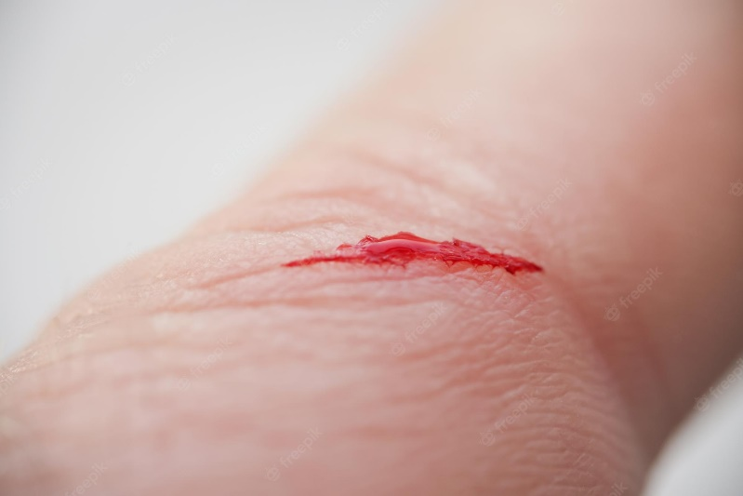
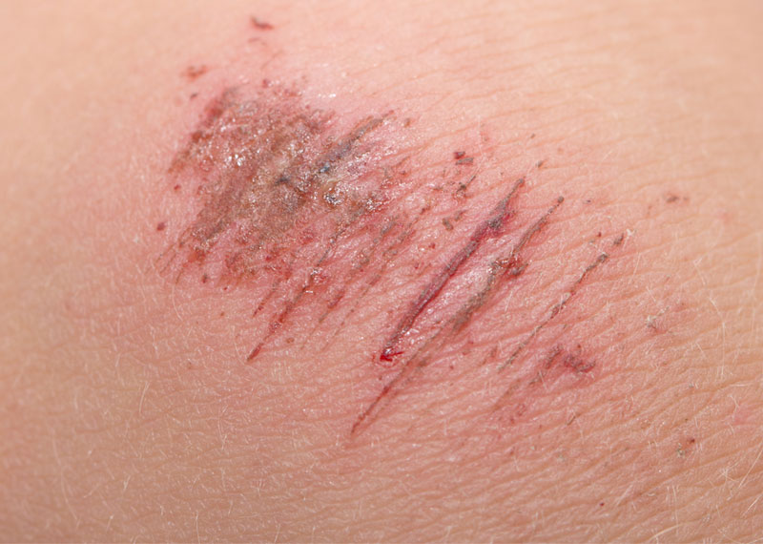
Cuts/Abrasions

Slide 2
Step 1 sa lahat
Dagdag magsuot ng BSI and PPE (mask and gloves)
Check if the scene is safe
Know what happened
Before proceeding, place the patient in a secure position
Sample picture ng stable ng pwesto

Slide 3
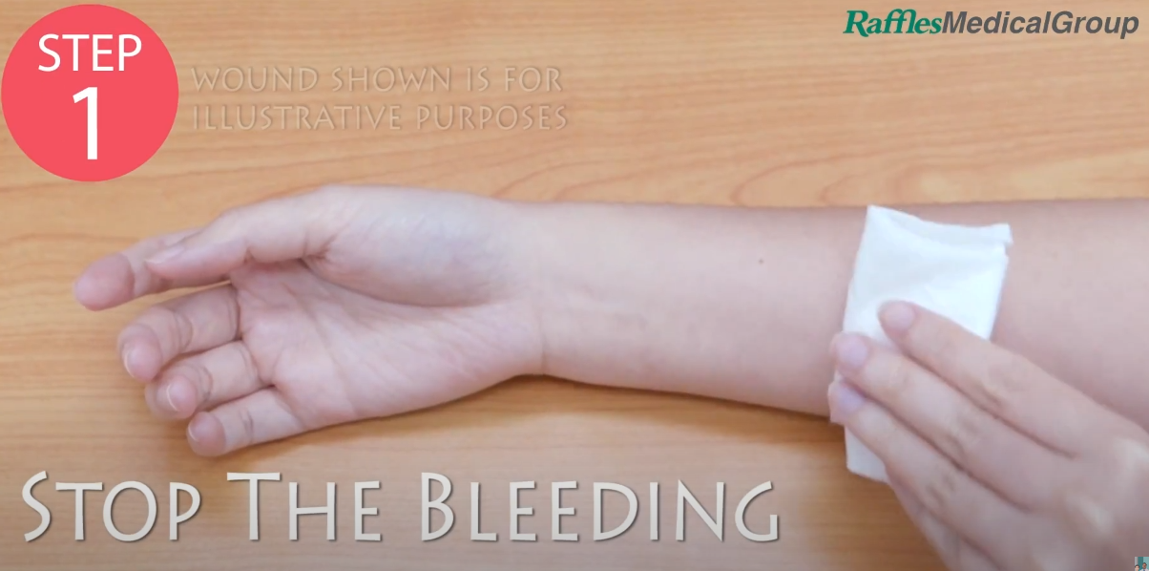
Step 1: Stop the bleeding
Apply pressure with a clean bandage or cloth, and keep that part of your body elevated above the heart, if possible
0:13

Slide 4
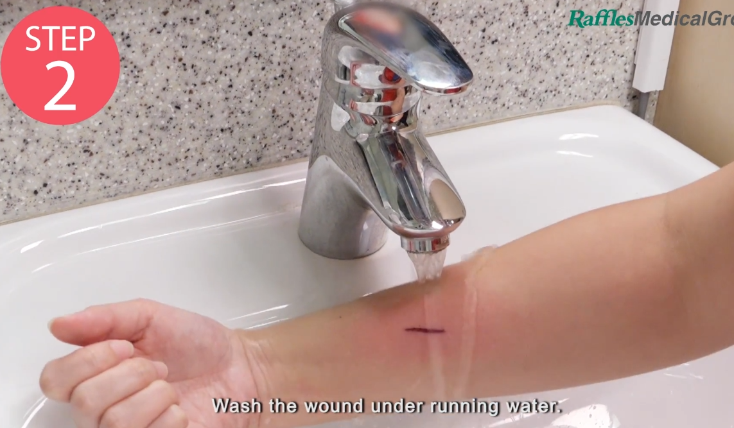
Step 2: Clean the wound
Rinse the wound with water. Keeping the wound under running tap water will reduce the risk of infection.
If water is not available, use povidone-iodine antiseptic solution to clean the wound.
0:20

Slide 5
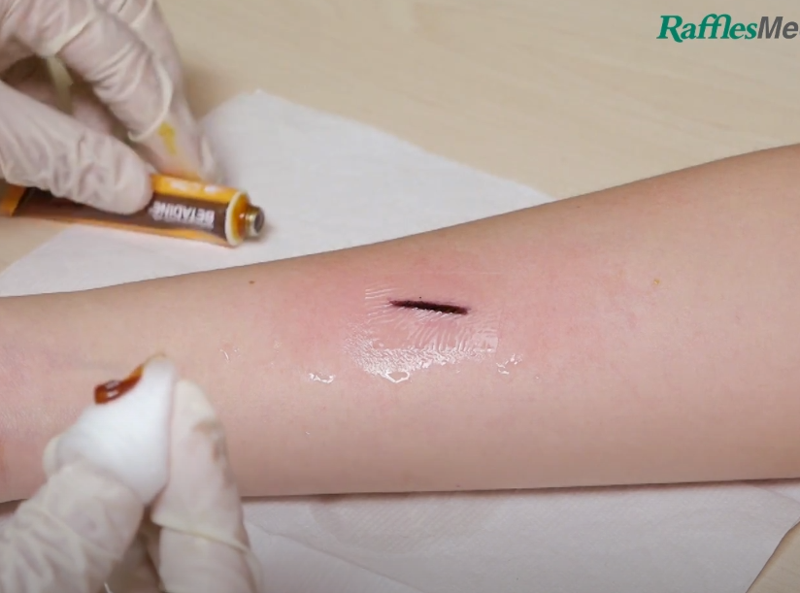
Step 3: Apply antibiotic
Apply a thin layer of an antibiotic ointment.
0:31

Slide 6
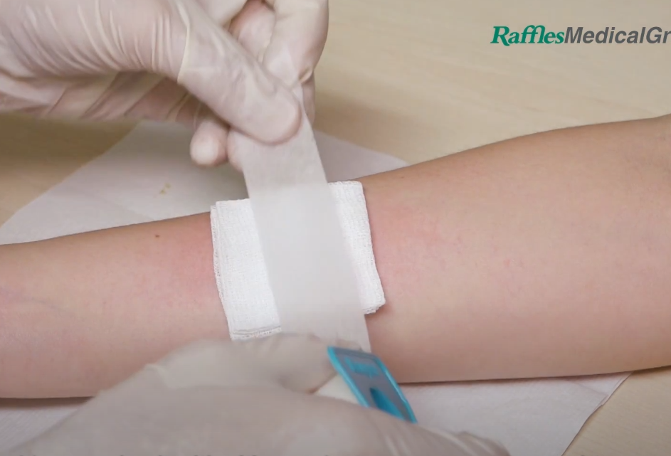
Step 4: Cover the wound
Apply a thin bandage or rolled gauze directly over the wound with pressure.
Secure with micropore tape on the wound dressing.
Wash hands after giving care
0:36

Slide 7
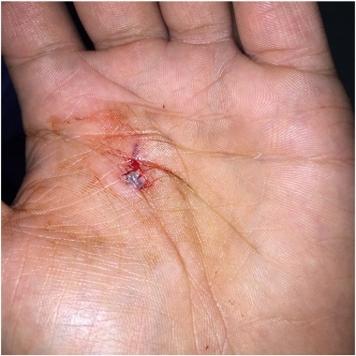
PUNCTURE

Slide 8
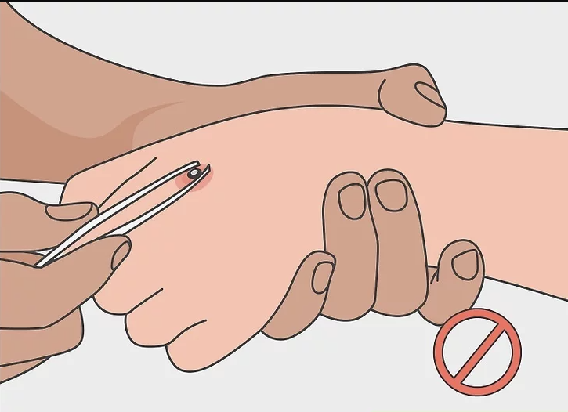
Warning!
If there are objects stuck in the wound, DO NOT attempt to remove them. Wait for medical personnel to arrive

Slide 9
Step 1: Stop the bleeding
Apply gentle pressure with a clean bandage or cloth, and keep that part of your body elevated above the heart, if possible
0:13

Slide 10
Step 2: Clean the wound
Rinse the wound with water. Keeping the wound under running tap water will reduce the risk of infection.
If water is not available, use betadine solution to clean the wound.
0:20

Slide 11
Step 3: Wait for the medical personnel
DO NOT cover the puncture and wait for medical personnel to arrive

Slide 12
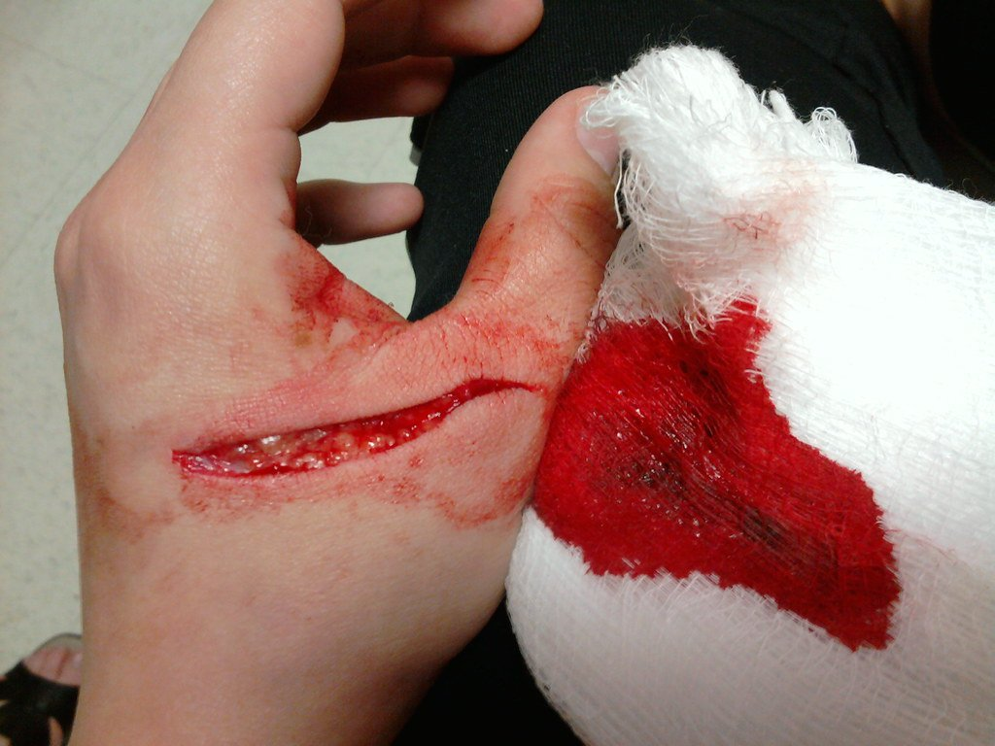
LACERATION

Slide 13
Step 1: Stop the bleeding
Apply gentle pressure with a clean bandage or cloth, and keep that part of your body elevated above the heart, if possible
0:13

Slide 14
Step 2: Clean the wound
Use betadine solution to clean the wound.
Video for laceration only
0:20

Slide 15
Step 4: Cover the wound
Secure the laceration with sterile strip to bind the skin together
Cover with sterile gauze under pressure
*Video for laceration only

Slide 16
Sources:
Video source: https://www.youtube.com/watch?v=AhANvBB9hz0
Steps source(s): https://www.mayoclinic.org/first-aid/first-aid-cuts/basics/art-20056711
https://www.piedmont.org/living-better/first-aid-101-how-to-treat-a-cut
Image source(s): https://galnet.fandom.com/wiki/ABRASIONS_AND_ITS_TYPES
https://www.freepik.com/premium-photo/injured-persons-finger-with-bleeding-open-cut-wound_21522096.htm
https://www.wikihow.com/images/thumb/e/e1/Treat-a-Puncture-Wound-Step-10-Version-4.jpg/aid189531-v4-728px-Treat-a-Puncture-Wound-Step-10-Version-4.jpg.webp
https://els-jbs-prod-cdn.jbs.elsevierhealth.com/cms/attachment/36766d86-072a-4b0a-a406-e69ce1d18648/gr1_lrg.jpg
https://www.tamingthesru.com/blog/masteringminorcare/handlacerations

Slide 17
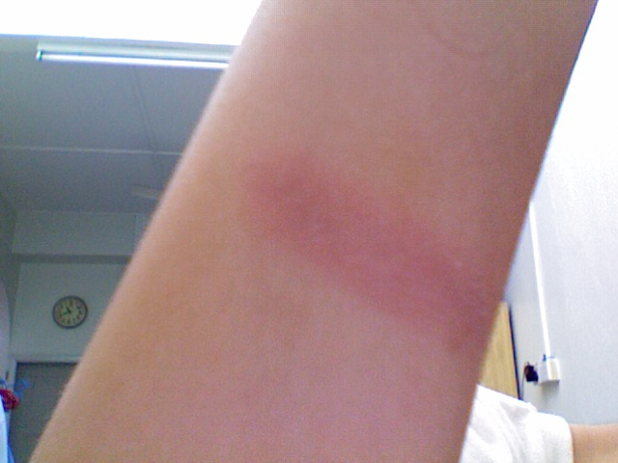
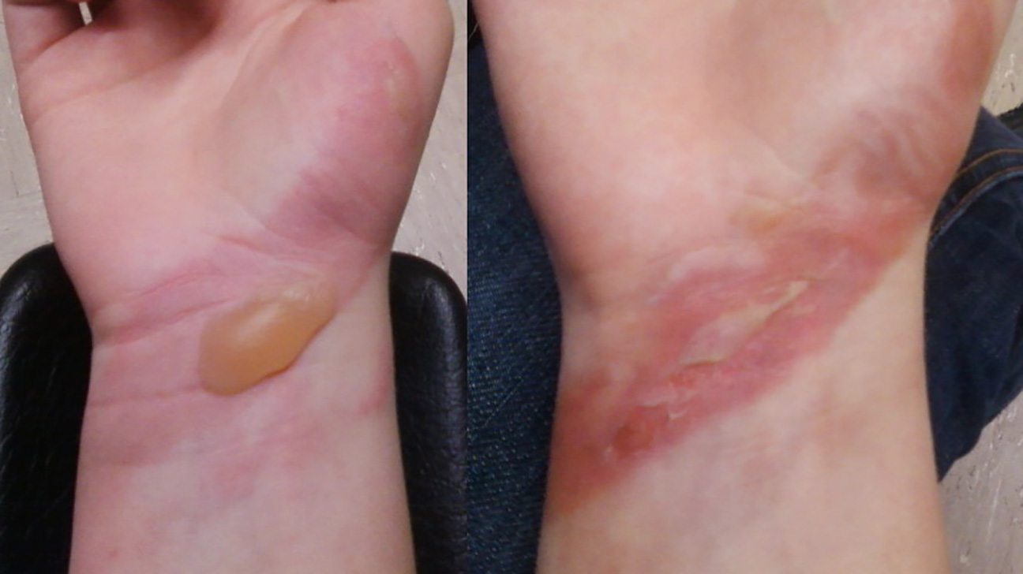
1st and 2nd Degree Burns/Paso
1st degree burn
2nd degree burn

Slide 18
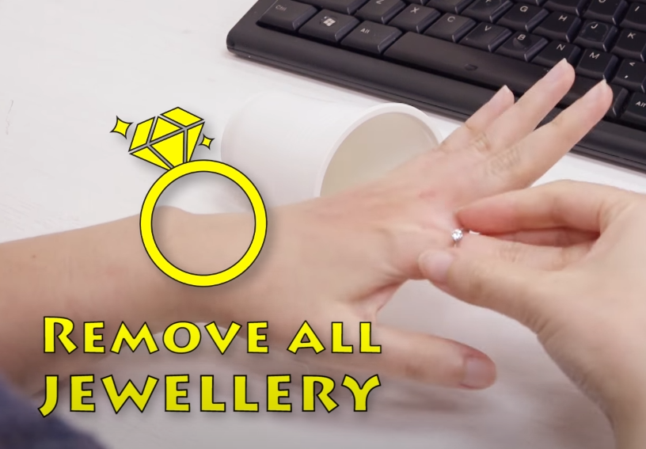
Note: Remove jewelries if present
Take off jewelry, belts, and tight clothing. Burns can swell quickly.

Slide 19
Step 1: Cool the burn
Hold burned skin under cool (not cold) running water until the pain subsides.
Use compresses if running water isn't available.
DO NOT use ice or ice water

Slide 20
Step 2: Do not apply anything (magkaiba for 1st and 2nd)
If 1st degree burn, apply burn ointment (please read the label for allergy precautions)
if 2nd degree burn, do not apply anything and wait for medical personnel

Slide 21
Step 3: Dress the wound
Loosely cover the burn with a nonstick, sterile bandage.
If blisters form, let them heal on their own while keeping the area covered.
DO NOT pop the blisters.

Slide 22
sources
Video source: https://www.youtube.com/watch?v=XGnLkUty69g
Steps Source(s): https://www.webmd.com/first-aid/thermal-heat-or-fire-burns-treatment#:~:text=For%20Second%2DDegree%20Burns%20(Affecting%20Top%202%20Layers%20of%20Skin),-1.&text=or%2015%20minutes.-,Use%20compresses%20if%20running%20water%20isn't%20available.,ointments%2C%20which%20can%20cause%20infection.
https://www.aad.org/public/everyday-care/injured-skin/burns/treat-minor-burns#:~:text=Immediately%20immerse%20the%20burn%20in,these%20may%20cause%20an%20infection
Image source(s): https://commons.wikimedia.org/wiki/File:First-degree_burn.jpg
https://www.verywellhealth.com/burn-pictures-4020409

Slide 23
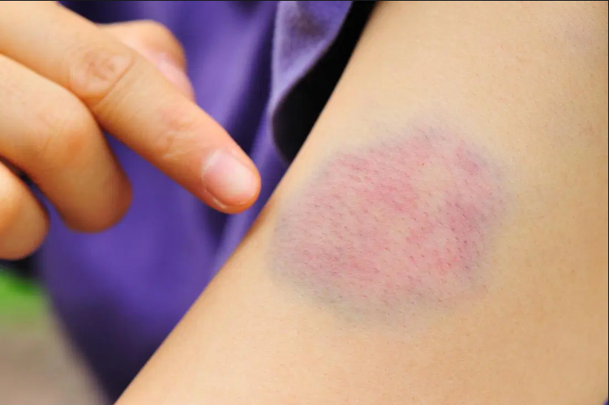
Bruises
https://www.medicalnewstoday.com/articles/320090#arnica-montana

Slide 24
Step 1: Cold compress
Dab a cold compress to the affected area to reduce the swelling for 10-15 minutes*.
DO NOT put ice directly on the skin
No video found (Kaya naman naten to gawin)

Slide 25
Sources
Step sources: https://skinsight.com/skin-conditions/first-aid-bruises/
Image source: https://medlineplus.gov/bruises.html

Slide 26
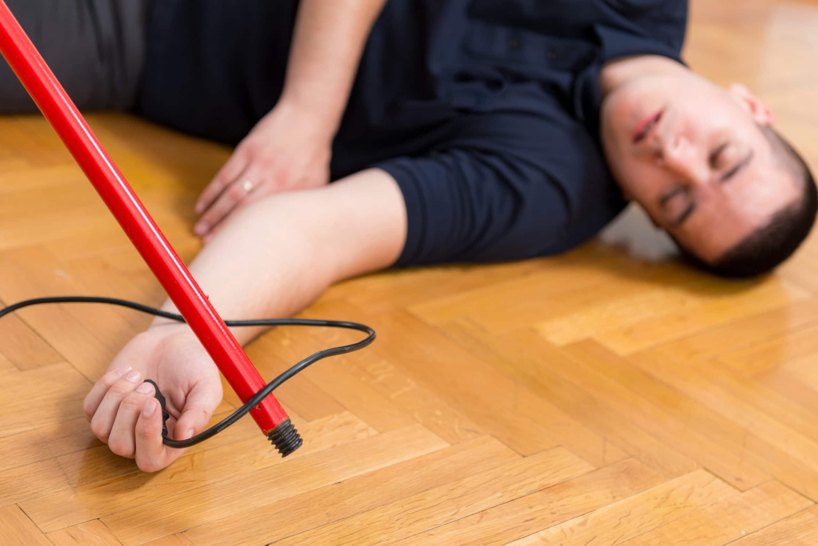

Electric Shock (Nakuryente)

Slide 27
Caution
Do not go near an injured person who is still in contact with an electrical current.
Don't move a person with an electrical injury unless there is immediate danger.

Slide 28
When to seek emergency care
Call the clinic or your local emergency number if the injured person experiences:
Severe burns (if a large part of the body is affected)
Difficulty breathing
Muscle pain and contractions
Uncontrollable movement
unconscious

Slide 29
Steps while waiting for medical help STEP 1: Separate the Person From the Current Source
To turn off power:
Unplug an appliance if the plug is undamaged or shut off power via the circuit breaker, fuse box, or outside switch.

Slide 30
STEP 2: Do CPR, if Capable (call emergency na agad)
When you can safely touch the person, do Cardio Pulmonary resuscitation if the person is pulseless and/or unresponsive.
Do this only if trained. Otherwise,
Wait for medical personnel
Look for entry and exit wounds

Slide 31
Sources:
Video
https://www.youtube.com/watch?v=ZY-WdRC_orU
Steps and pictures
https://www.mayoclinic.org/first-aid/first-aid-electrical-shock/basics/art-20056695
https://www.webmd.com/first-aid/electric-shock-treatment
https://www.safetyfirstaid.co.uk/electric-shock-first-aid-treatment/

Slide 32
Chemical Poisoning
Ingestion
Inhalation
On skin
On eyes

Slide 33
Common Symptoms of chemical poisoning
Dizziness
Disorientation
Vomiting
Trouble breathing
Pain
Headaches
Feeling faint

Slide 34
What to do while waiting for help Swallowed Poison STEP 1: Comfortable position
If the casualty is having trouble breathing, sit them down and help them into a position that aids breathing.
Check the level of consciousness of the patient

Slide 35
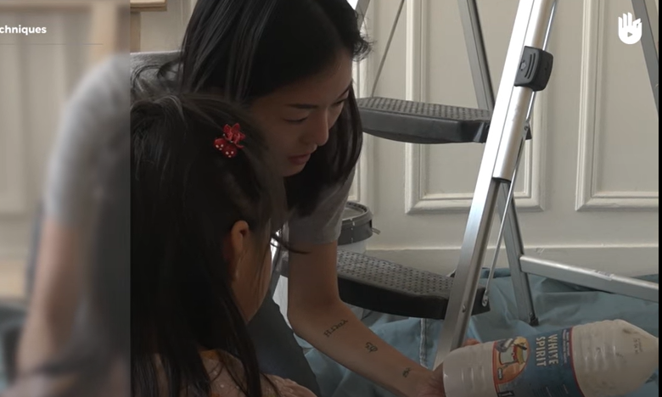
STEP 2: Determine the cause of the poisoning
Determine, secure and note the container of toxic product that caused the poisoning.

Slide 36
Step 3: Wait the medical personnel
NOTE
While waiting for the clinic staff, DO NOT give the casualty anything to eat or drink
DO NOT make them vomit, because the toxic product will burn the lining of the mouth and esophagus a second time on the way up.
If the patient vomits, set aside the vomit for classification.

Slide 37
Inhalation
Bring the person to a well-ventilated area as soon as possible.
Remove the tight clothes and untie the necktie.
Wait for the medical personnel to arrive.
NOTE: DO NOT give the patient anything to inhale

Slide 38
Skin spill
On Skin: Remove any contaminated clothing using gloves.
Rinse the skin for 15 to 20 minutes in running water.
DO NOT apply any medication or chemicals to the contaminated skin least they should aggravate the skin damage.
Go to the clinic or Wait for the medical personnel to arrive.
On Eyes: Gently flush the eye with running water for 20 minutes or until help arrives.
DO NOT use eye drops.
Go to the clinic or Wait for the medical personnel to arrive.
Eye spill

Slide 39
Others (manual type)
Difficulty of breathing
Fracture, concussion,
Loss of consciousness
Wait for medical personnel scan QR patient, etc.

Slide 40
Sources:
Video:
https://www.youtube.com/watch?v=Zo0VK1tJHAM
Steps and Pics:
https://www.moh.gov.sa/en/HealthAwareness/EducationalContent/Firstaid/Pages/005.aspx
https://www.mayoclinic.org/first-aid/first-aid-poisoning/basics/art-20056657

Slide 41
SHORTNESS OF BREATH

Slide 42
Symptoms:
People having breathing difficulty will often look uncomfortable. They may be:
Breathing rapidly
Unable to breathe lying down and need to sit up to breathe
Very anxious and agitated
Sleepy or confused.

Slide 43
Step 1:
Check the person's airway, breathing, and pulse. If necessary, begin CPR.

Slide 44
Step 2:
Loosen any tight clothing or anything that restricts the patient to get enough air.

Slide 45
Step 3:
If the patient is asthmatic or has any kind of medication, help the person use any prescribed medicine (such as an asthma inhaler or home oxygen).

Slide 46
Step 4:
Continue to monitor the person's breathing and pulse until medical help arrives. DO NOT assume that the person's condition is improving if you can no longer hear abnormal breath sounds, such as wheezing.

Slide 47
Sources:
https://medlineplus.gov/ency/article/000007.htm?fbclid=IwAR0deenHkh8rgLL_iJE1YpJy1zDQGWdF0fs1vyem7kZ4o0NLNWPmj6XkRNg
https://www.youtube.com/watch?v=ccr4lKZjHks

